Slide 1
INDIA'S ONLINE VEGETABLE MARKET

Slide 2
ABSTRACT:
India's online vegetable market is an application developed in java technology for maintaining centralized repository of all the information related to vegetables and Markets. This application provides information about different vegetables. This application makes the information about vegetables easy and which markets available in the specific vegetables. Getting the information about Markets and vegetables.

Slide 3
INTRODUCTION:
The project Centralized Online Vegetable Portal is a web application which maintains information about vegetables. This application also makes vegetables wise in different markets. With the help of this application user can be able to know the best value for his vegetable fooled by the marketers. This application makes the users requirement become easy .By using this application users can get the complete information about eradicating black marketing and inflation. It helps in proper maintenance of data and information. One can easily browse through the various details using the well defined interfaces provided by the system.

Slide 4
OBJECTIVE:
The main objective of Centralized Online Vegetable Portal is to develop a website which will help users even though the admin will get best from his input.

Slide 5
SYSTEM ANALYSIS

Slide 6
EXISTING SYSTEM:
In olden days we experienced this type of situation like we are go to the market you doesn’t satisfied with vegetables prices, and don’t know the vegetable prices.
You shouldn’t remember the previous price about vegetables.
Users can’t get the complete information about eradicating black marketing and inflation.
Users can’t get the information about which vegetables are available or not, and if it is not there we are go to another market.
In case there also not providing those vegetables, users’ time wasted.

Slide 7
PROPOSED SYSTEM:
The development of this new system contains the following activities, which try to automate the entire process keeping in the view of database integration approach.
The Centralized Online Vegetable Portal having the full information about vegetables and markets.
Users get the full information about vegetables and those vegetables are available or not in specific markets and how much price in the different markets.
Vegetables prices increasing or decreasing that information also available in this vegetable portal.
Users can search on different markets in different vegetables available or not and how much price of vegetables in different markets.

Slide 8
MODULES:
Admin:
Market:
Adding the market information.
View the market information.
Vegetables:
Adding the vegetables information.
View the vegetables information.

Slide 9
MODULES:
Vegetables Price:
Adding market wise vegetables and cost.
Adding the cost of the vegetables and check the information about vegetables like a cost.
Search on market wise price on specific vegetable.
Admin can search on vegetable wise prices in different markets i.e. compare with vegetable in different markets.
Admin can update the vegetables prices in different markets.

Slide 10
MODULES:
USER:
View vegetable prices in different vegetables.
View vegetables prices in different markets.
User can know the information vegetables prices can be increasing or decreasing.
That information can update only administrator.
SECURITY AND AUTHENCATION:
The user details should be verified against the details in the user tables and if it is valid user, they should be entered into the system.
Once entered, based on the user type access to the different modules to be enabled / disabled and individual user can change their default password or old password.

Slide 11
SYSTEM REQUIREMENTS

Slide 12
SOFTWAE REQUIREMENTS
Operating System : Windows/2003/ or Linux/Solaris (Any)
User Interface : HTML, CSS
Client-side Scripting : JavaScript
Programming Language : Java
Web Applications : JDBC, Servlets, JSP
IDE/Workbench : My Eclipse 8.6
Database : Oracle10g XE
Server Deployment : Tomcat

Slide 13
HARDWARE REQUIREMENTS
Processor : Core 2 Duo
Hard Disk : 160GB
RAM : 1 GB

Slide 14
SYSTEM REQUIREMENT SPECIFICATION

Slide 15
System requirements specification: A structured collection of information that embodies the requirements of a system. A business analyst, sometimes titled system analyst, is responsible for analyzing the business needs of their clients and stakeholders to help identify business problems and propose solutions. Within the systems development life cycle domain, typically performs a liaison function between the business side of an enterprise and the information technology department or external service providers. Projects are subject to three sorts of requirements:
Business requirements
Product requirements
Process requirements

Slide 16
Modules:
Admin:
Market:
Adding the market information.
View the market information.
Vegetables:
Adding the vegetables information.
View the vegetables information.
Vegetables Price:
Adding market wise vegetables and cost.
Adding the cost of the vegetables and check the information about vegetables like a cost.

Slide 17
Search on market wise price on specific vegetable.
Admin can search on vegetable wise prices in different markets i.e. compare with vegetable in different markets.
Admin can update the vegetables prices in different markets.
USER:
View vegetable prices in different vegetables.
View vegetables prices in different markets.
User can know the information vegetables prices can be increasing or decreasing.
That information can update only administrator.
SECURITY AND AUTHENCATION:
The user details should be verified against the details in the user tables and if it is valid user, they should be entered into the system.
Once entered, based on the user type access to the different modules to be enabled / disabled and individual user can change their default password or old password.

Slide 18
FEASIBILITY STUDY

Slide 19
TECHNICAL FEASIBILITY:
Evaluating the technical feasibility is the trickiest part of a feasibility study. This is because, at this point in time, not too many detailed design of the system, making it difficult to access issues like performance, costs on (on account of the kind of technology to be deployed) etc. A number of issues have to be considered while doing a technical analysis.
Understand the different technologies involved in the proposed system
Find out whether the organization currently possesses the required technologies
Operational Feasibility:
Proposed project is beneficial only if it can be turned into information systems that will meet the organizations operating requirements. Simply stated, this test of feasibility asks if the system will work when it is developed and installed. Are there major barriers to Implementation? Here are questions that will help test the operational feasibility of a project : Is there sufficient support for the project from management from users? If the current system is well liked and used to the extent that persons will not be able to see reasons for change, there may be resistance.

Slide 20
Economic Feasibility:
Economic feasibility attempts 2 weigh the costs of developing and implementing a new system, against the benefits that would accrue from having the new system in place. This feasibility study gives the top management the economic justification for the new system.

Slide 21
DATA FLOW DIAGRAMS

Slide 22
A graphical tool used to describe and analyze the moment of data through a system manual or automated including the process, stores of data, and delays in the system. Data Flow Diagrams are the central tool and the basis from which other components are developed. The transformation of data from input to output, through processes, may be described logically and independently of the physical components associated with the system. The DFD is also know as a data flow graph or a bubble chart.
Dataflow: Data move in a specific direction from an origin to a destination.
Process: People, procedures, or devices that use or produce (Transform) Data. The physical component is not identified.
Source: External sources or destination of data, which may be People, programs, organizations or other entities.
Data Store: Here data are stored or referenced by a process in the System.

Slide 23
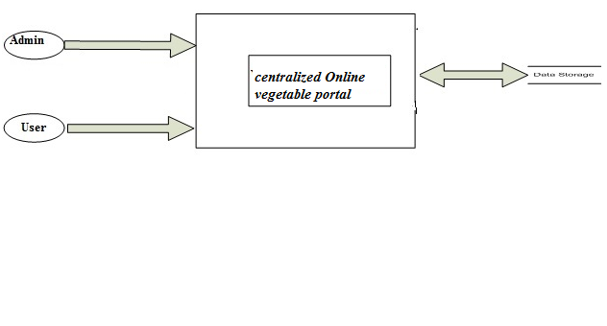
CONTEXT LEVEL 0 DIAGRAM:

Slide 24
CONTEXT LEVEL1 DIAGRAM:
LOGIN DFD

Slide 25
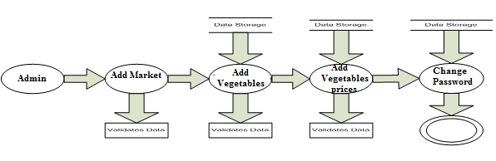
CONTEXT LEVEL2 DIAGRAM:

Slide 26
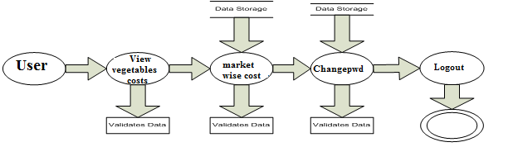
CONTEXT LEVEL3 DIAGRAM:

Slide 27
SDLC METHODOLOGIES

Slide 28
This document play a vital role in the development of life cycle (SDLC) as it describes the complete requirement of the system. It means for use by developers and will be the basic during testing phase. Any changes made to the requirements in the future will have to go through formal change approval process.
SPIRAL MODEL was defined by Barry Boehm in his 1988 article, “A spiral Model of Software Development and Enhancement. This model was not the first model to discuss iterative development, but it was the first model to explain why the iteration models.
The steps for Spiral Model can be generalized as follows:
The new system requirements are defined in as much details as possible. This usually involves interviewing a number of users representing all the external or internal users and other aspects of the existing system.
A preliminary design is created for the new system.
A first prototype of the new system is constructed from the preliminary design. This is usually a scaled-down system, and represents an approximation of the characteristics of the final product.

Slide 29
A second prototype is evolved by a fourfold procedure:
Evaluating the first prototype in terms of its strengths, weakness, and risks.
Defining the requirements of the second prototype.
Planning an designing the second prototype.
Constructing and testing the second prototype.
Risk factors might involved development cost overruns, operating-cost miscalculation, or any other factor that could, in the customer’s judgment, result in a less-than-satisfactory final product.
The existing prototype is evaluated in the same manner as was the previous prototype, and if necessary, another prototype is developed from it according to the fourfold procedure outlined above.
The preceding steps are iterated until the customer is satisfied that the refined prototype represents the final product desired.
The final system is constructed, based on the refined prototype.
The final system is thoroughly evaluated and tested. Routine maintenance is carried on a continuing basis to prevent large scale failures and to minimize down time.

Slide 30
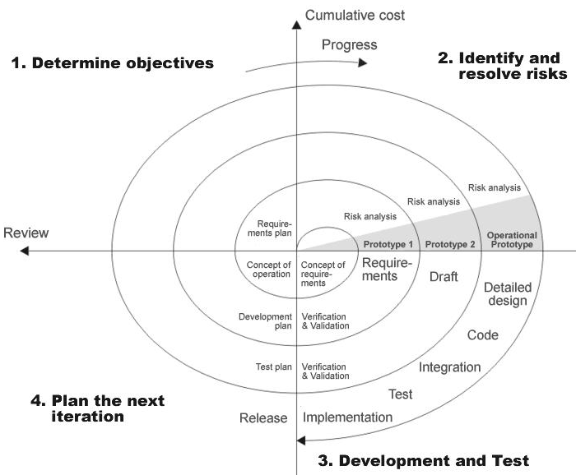
THE FOLLOWING DIAGRAM SHOWS HOW A SPIRAL MODEL ACTS LIKE:

Slide 31
ADVANTAGES OF SPIRAL MODEL:
Estimates(i.e. budget, schedule etc .) become more realistic as work progresses, because important issues discovered earlier.
It is more able to cope with the changes that are software development generally entails.
Software engineers can get their hands in and start working on the core of a project earlier.

Slide 32
E-R DIAGRAM

Slide 33
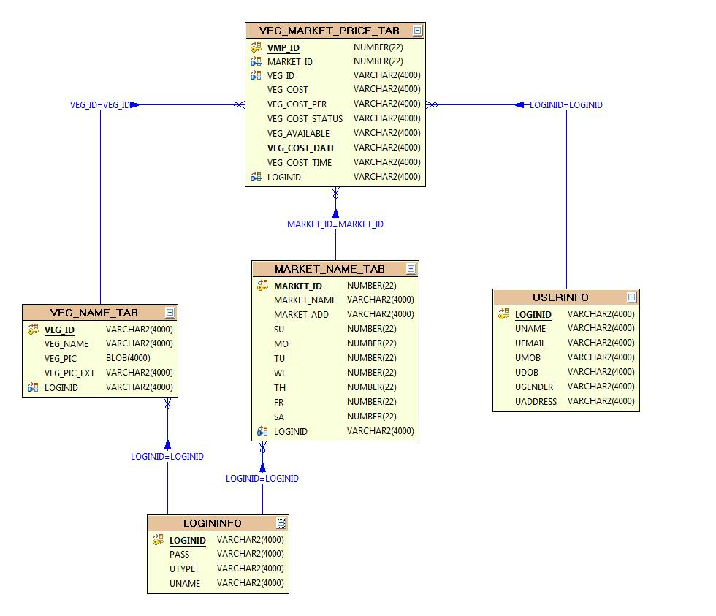

Slide 34
UML DIAGRAMS

Slide 35
The Unified Modeling Language allows the software engineer to express an analysis model using the modeling notation that is governed by a set of syntactic semantic and pragmatic rules.
A UML system is represented using five different views that describe the system from distinctly different perspective. Each view is defined by a set of diagram, which is as follows.
User Model View.
Structural Model View.
Behavioral Model View.
Implement Model View.
Environmental Model View.
UML is specifically constructed through two different domains they are:
UML Analysis modeling, this focuses on the user model and structural model views of the system.
UML design modeling, which focuses on the behavioral modeling, implementation modeling and environmental model views.

Slide 36
USE CASE DIAGRAMS

Slide 38
ADMIN USE CASE DIAGRAM:

Slide 39
USER USE CASE DIAGRAM:

Slide 40
SEQUENCE DIAGRAMS

Slide 41
ADMIN SEQUENCE DIAGRAM:

Slide 42
USER SEQUENCE DIAGRAM:

Slide 43
COLLABORATION DIAGRAM

Slide 44
ADMIN COLLABORATION DIAGRAM:

Slide 45
USER COLLABORATION DIAGRAM:

Slide 46
ACTIVITY DIAGRAMS

Slide 47
ADMIN STATE CHART DIAGRAM:

Slide 48
USER STATE CHART DIAGRAM

Slide 49
ADMIN ACTIVITY DIAGRAM

Slide 50
USER ACTIVITY DIAGRAM:

Slide 51
COMPONENT DIAGRAM

Slide 53
DEPLOYMENT DIAGRAM

Slide 54
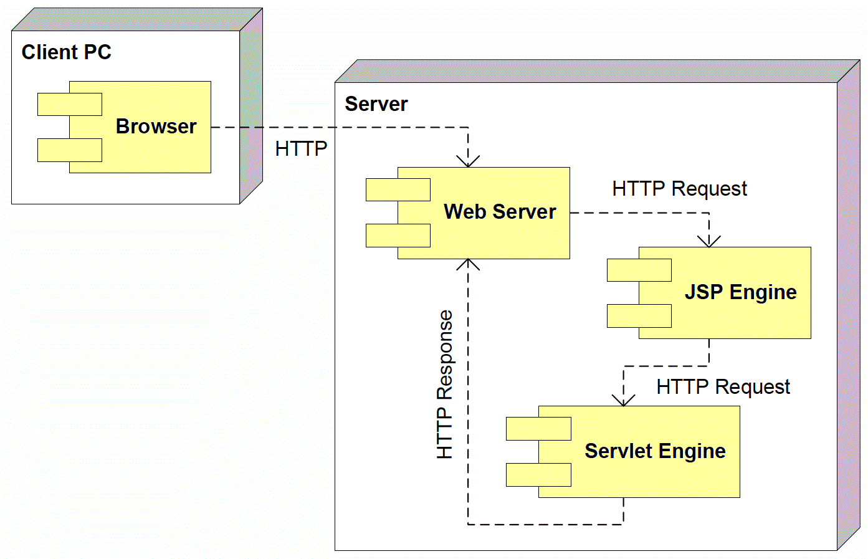

Slide 55
OUTPUT SCREENS

Slide 56
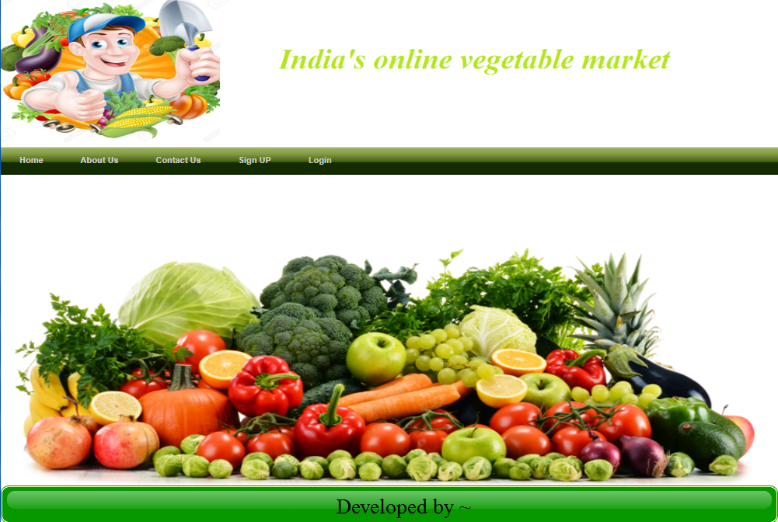
Home

Slide 57
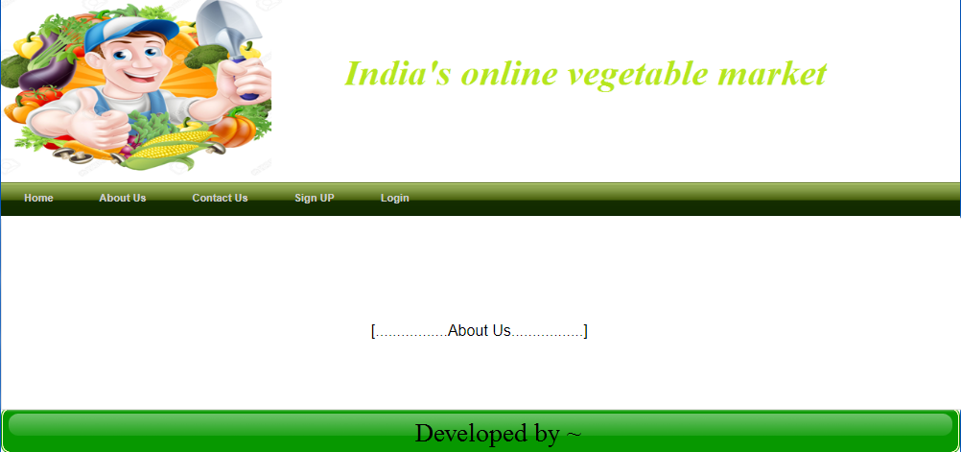

Slide 58
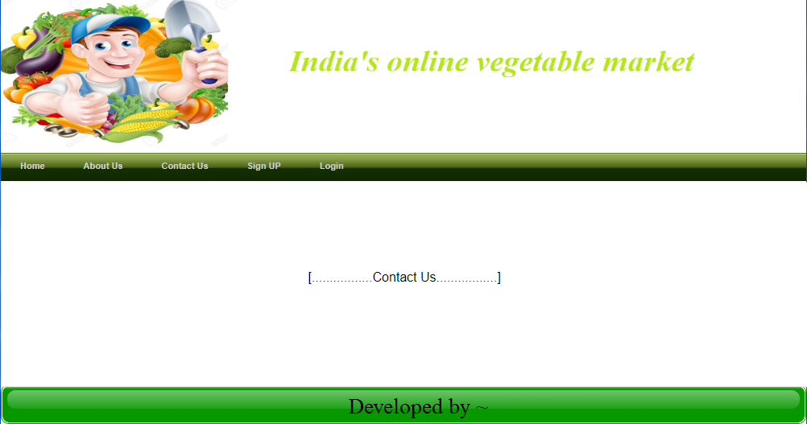

Slide 59
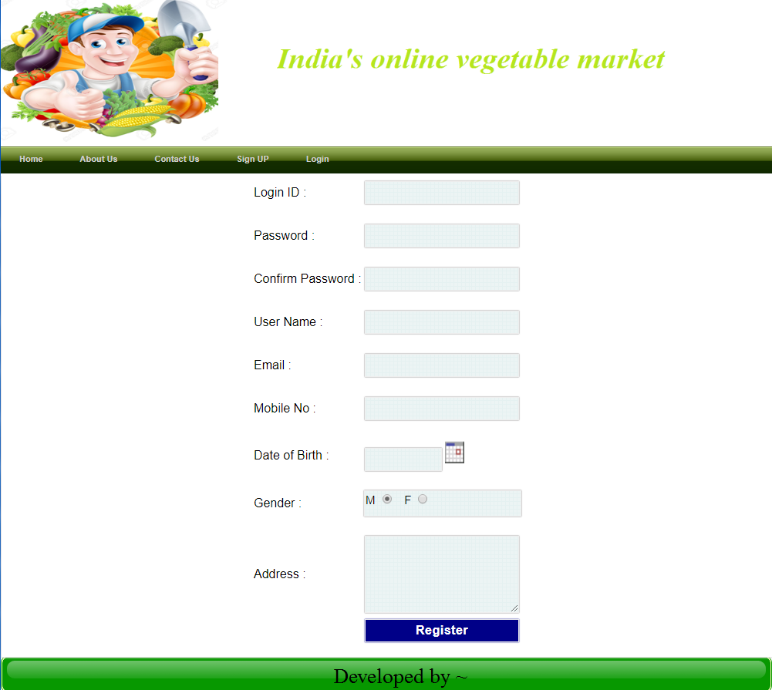

Slide 60
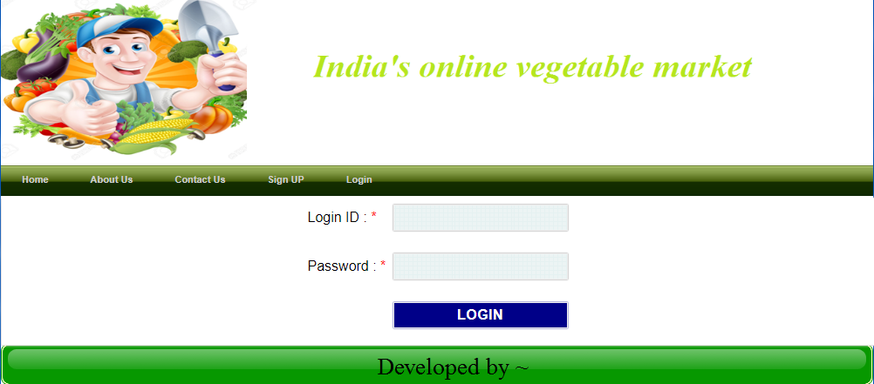

Slide 61
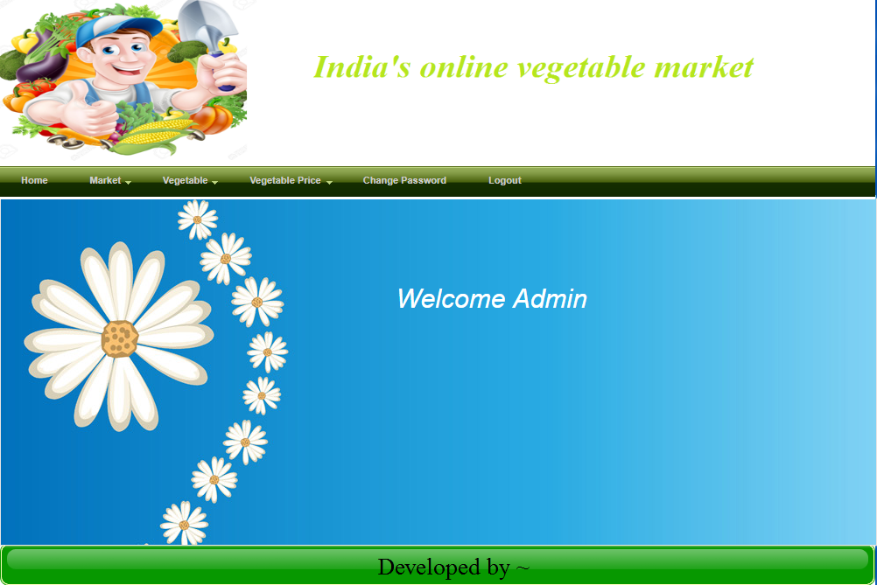
Admin

Slide 62
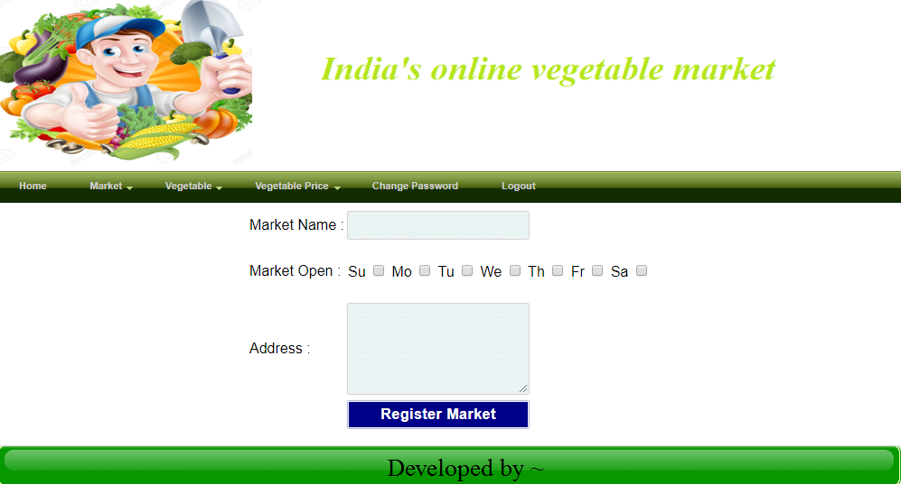

Slide 63
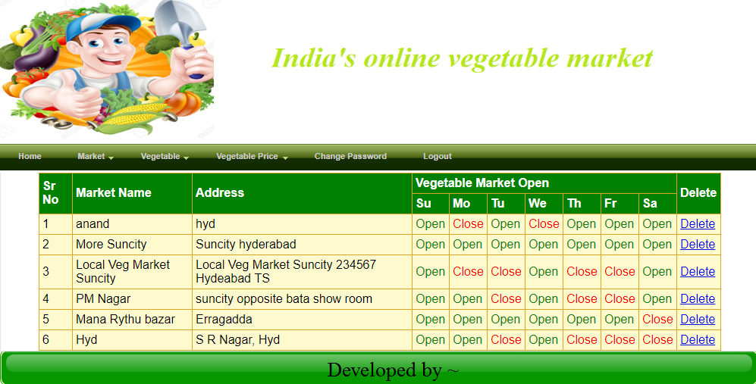

Slide 64
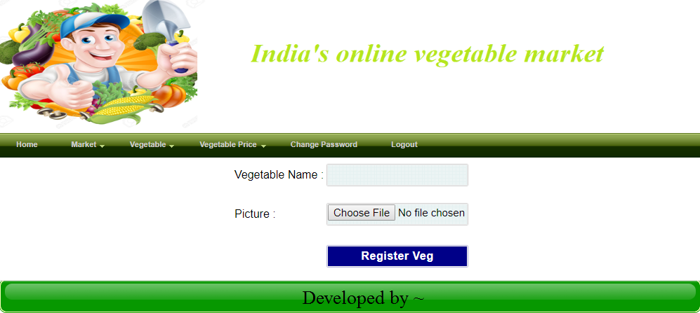

Slide 65
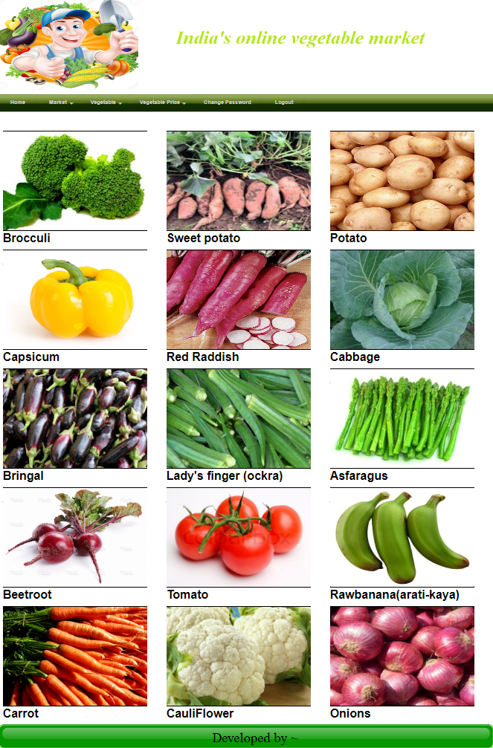

Slide 66
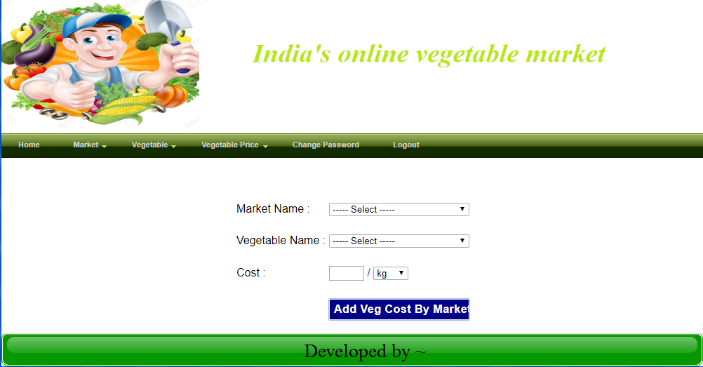

Slide 67
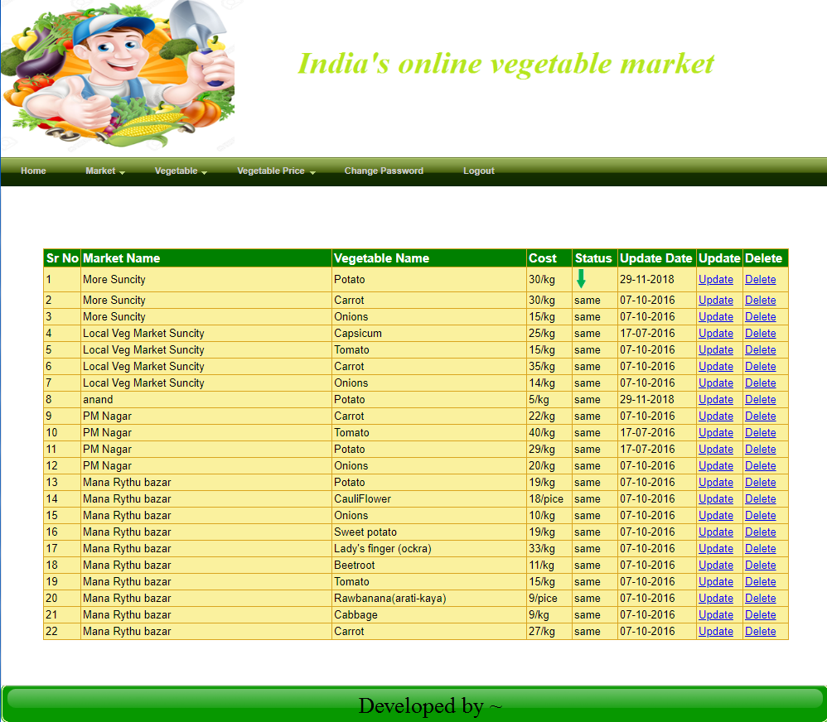

Slide 68
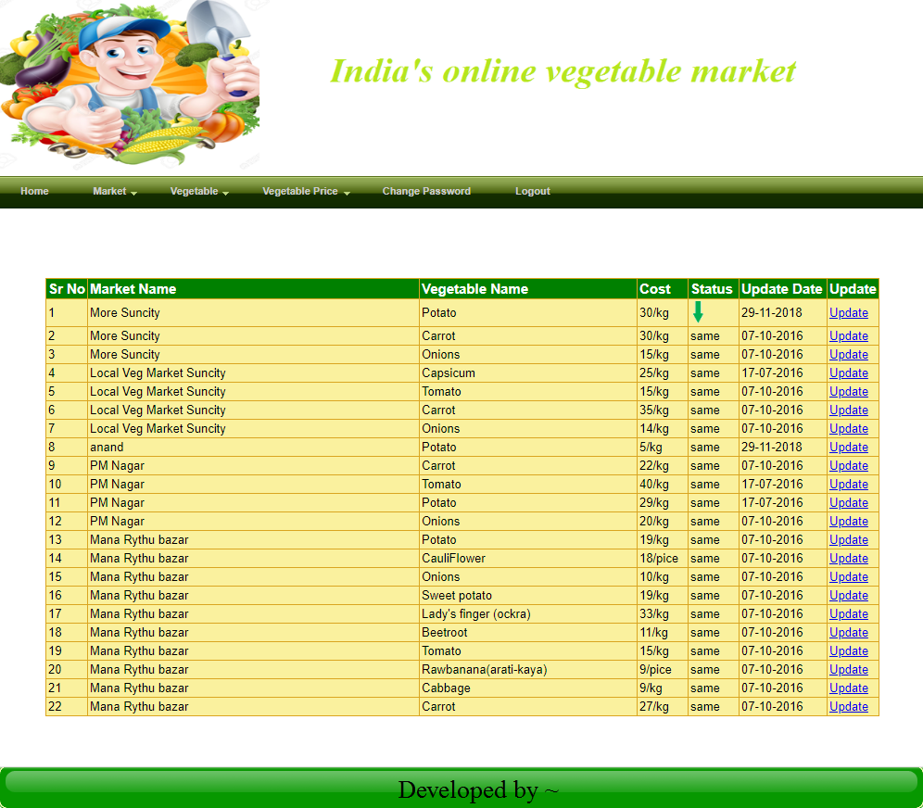

Slide 69
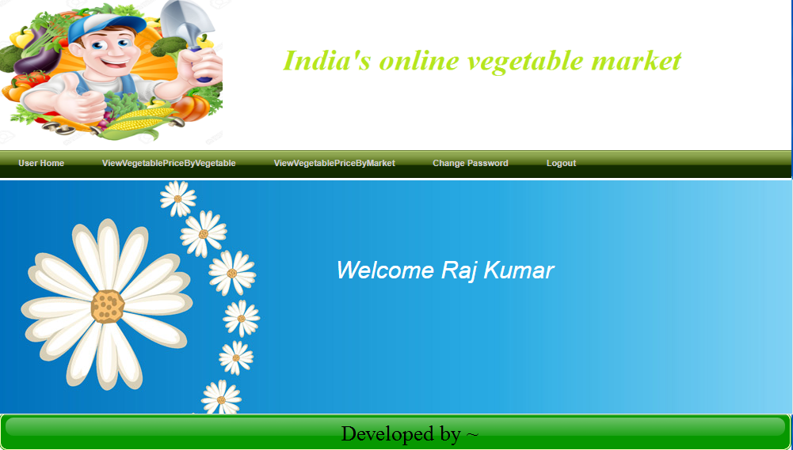
User

Slide 70
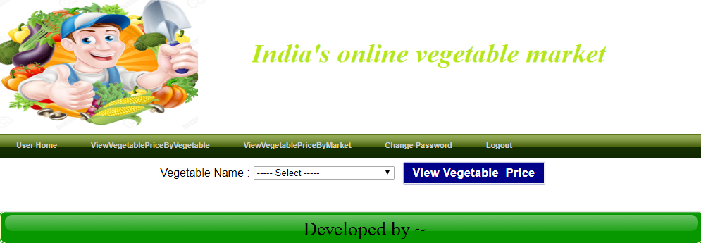

Slide 71
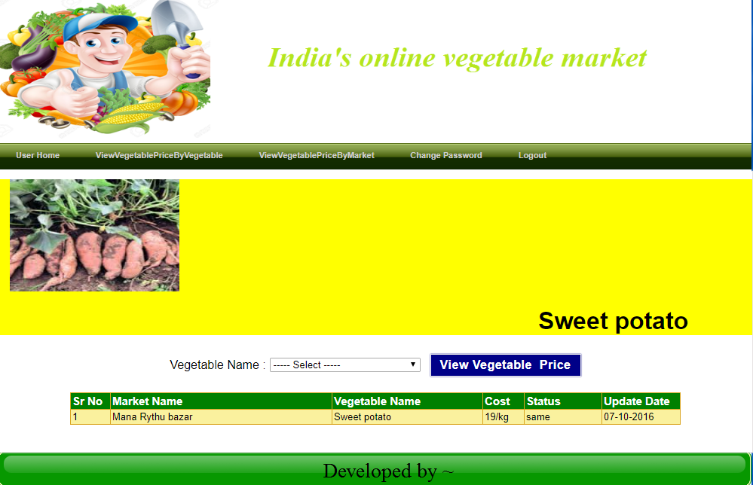

Slide 72
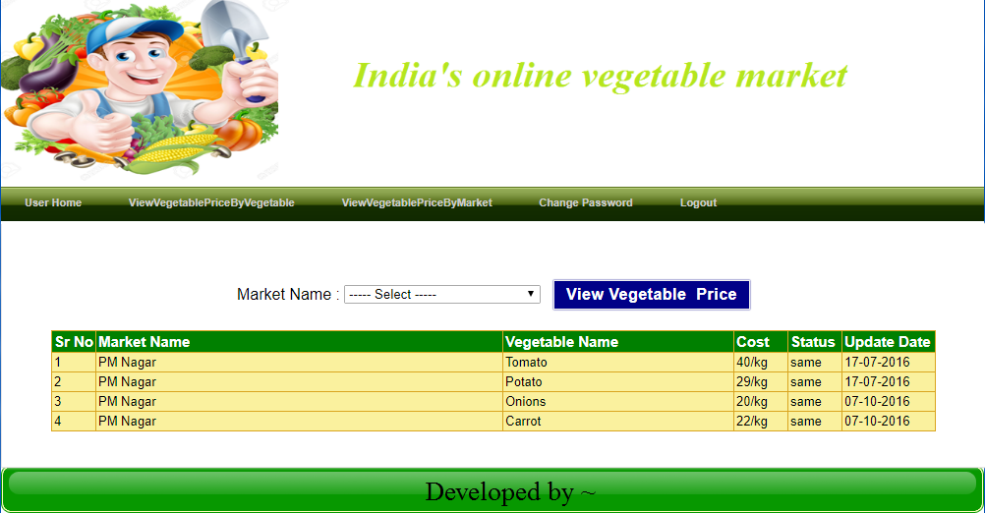

Slide 73
THANK YOU

